Slide 1
Employee Data Analysis using Excel
STUDENT NAME: M.GIRIDHARAN
REGISTER NO: C01B54CFAC8B40A8C8A4E22FD550E6F7/
asunm1455312213723
DEPARTMENT: B.COM(COMPUTER APLLICATION)
COLLEGE: TAGORE ART & SCIENCE COLLEGE

Slide 2
PROJECT TITLE
Employee Performance Analysis using Excel

Slide 3


AGENDA
Problem Statement
Project Overview
End Users
Our Solution and Proposition
Dataset Description
Modelling Approach
Results and Discussion
Conclusion
3/21/2024 Annual Review

Slide 4

PROBLEM STATEMENT
A problem statement for employee data analysis can help your identify areas for improvement, align your HR analytics strategy with your buisness goals, and communicate your objectives to stakeholders

Slide 5

PROJECT OVERVIEW
Understand the buisness
Get the data
Exlpore and the data
Enrich the dataset
Build visualizations
Get predictive
Iterate

Slide 6

WHO ARE THE END USERS?
Managers
Data Scientists
Large Scale Industries
Super users and
Report Builders
Employee
Human Resource

Slide 7

OUR SOLUTION AND ITS VALUE PROPOSITION
1. Pivot table - help to analyze large amounts of data
2. Condtional formatting - to highlight patterns
3. Formulas - calculate mathematical expression on values
4. . Graph - for data visulize
5. Filters - help you narrow down data in a table or range
6. Charts - visual representative of data

Slide 8
Dataset Description
The Employee Data set is form “Edunet Dashboard”
we took 9 features out of 26 features :
Employee name
Employee id number
Employee type
Gender code
Performance level
Ratings
Date
Email
Address

Slide 9

THE "WOW" IN OUR SOLUTION
Perfomance level :
converting the numerical ratings to text like(very
high, high, med,low,true)
Formula = IFS(Z7>=5,”very high”,Z7>=4,”high”,Z7>=3,”med”,”
low”,”true”)
3/21/2024 Annual Review

Slide 10
MODELLING
Data collection :
The data collected from Edunet Dashboards
Features selection :
Features selection 9 out of 26 features which is required for Analysis the Employee performance
a. Employee name
b. Employee id
c .Employee type
d. Gender
e. Performance level and ratings
Data cleaning :
1. identifying the missing values
2. eliminating th missing values
3. to filter the formats

Slide 11
MODELLING
Performance level :
Level calculated by manipulating the rating of the employees
Summary :
Pivot table created by considering selected features of the Employee dataset then generated the bar diagram by using Excel

Slide 12
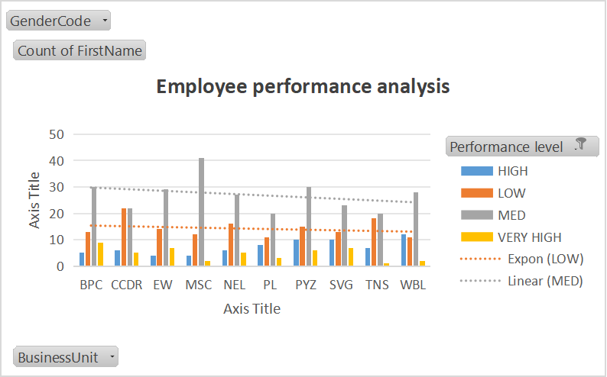
RESULTS

Slide 13
conclusion
The Conclusion is the majority of Employee Dataset is in med level compare to the dataset motive them
to reach like higher (or) very high the will we have the stable empolyee and Eliminating the entire low level as much possible by training the well .

